Slide 1

Effective and Systematic Software Testing
Chapter 1
https://www.effective-software-testing.com

Slide 2
What are the top-3 keywords (max 2 terms each) that best sum up the content of the chapter?

Slide 3
What is Chapter 1 about?
Effective and systematic testing vs gut feeling testing
John vs Eleanor
Testing principles
Exhaustive testing is impossible
Knowing when to stop
Variability is important (the pesticide paradox)
Bugs happen in some places more than others (defect clusters)
Testing will never be perfect
Context is king
Verification is not validation
Testing pyramid
Unit, integration, and system testing

Slide 4
Effective testing
Gut-feeling tests: what characterizes John's behavior?
What makes Eleanor's behavior more systematic?
Discuss in groups of 3
Our goal is to come up with one sentence that explains what gut feeling testing is, and another one explaining what systematic testing is.
You have 7 minutes.

Slide 5
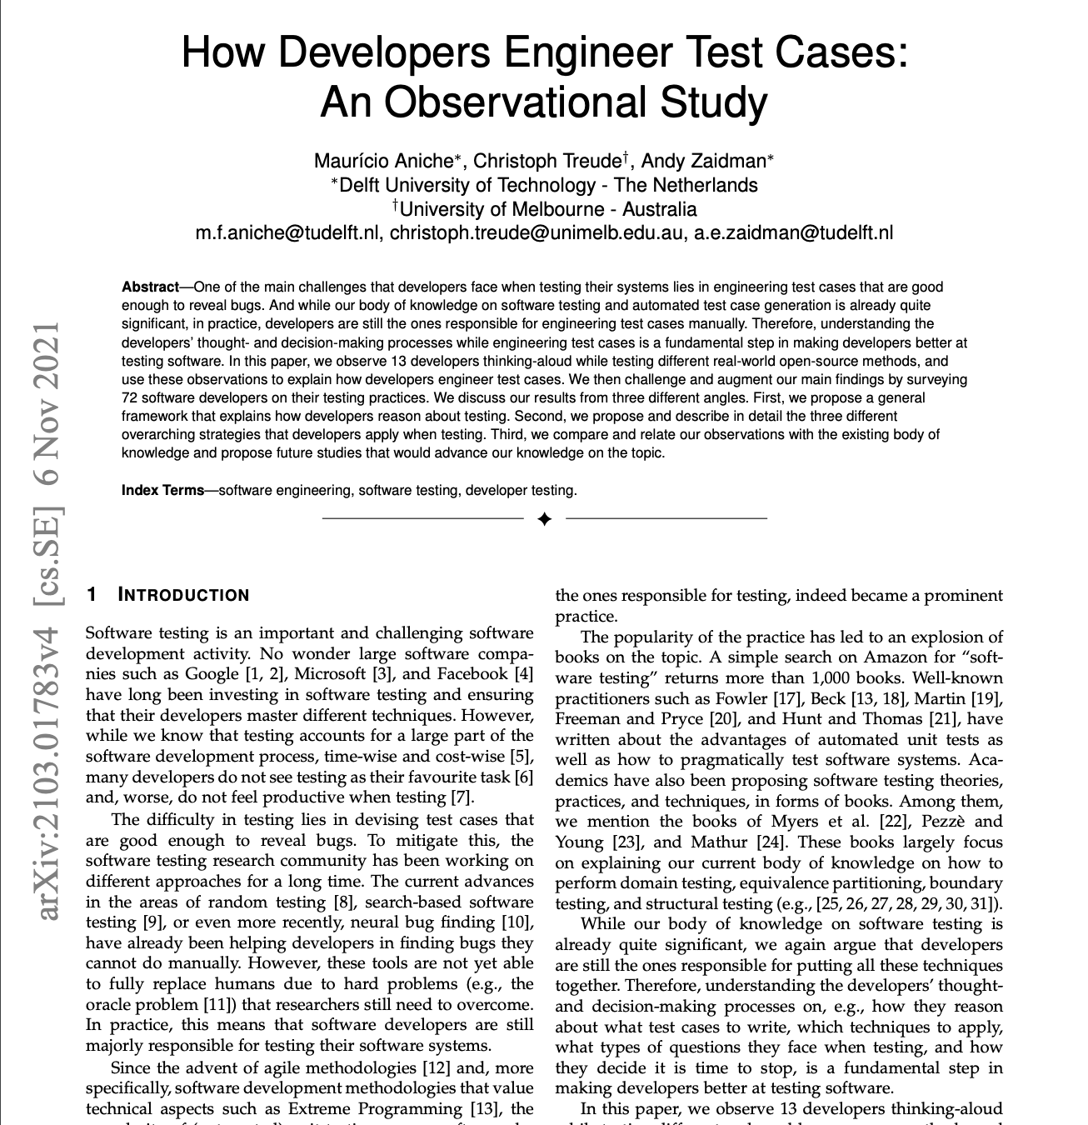
We observed 13 professional developers testing a piece of code.
Some developers are more driven by documentation, others by source code.
Only 1 developer was systematic in the way he tested the code. Others followed their gut feelings.
What do we learn from this?

Slide 6
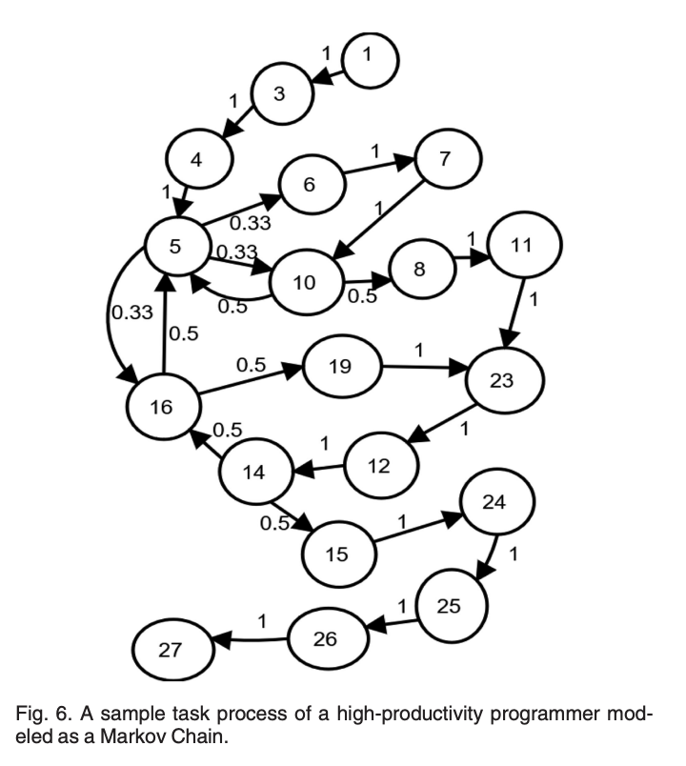
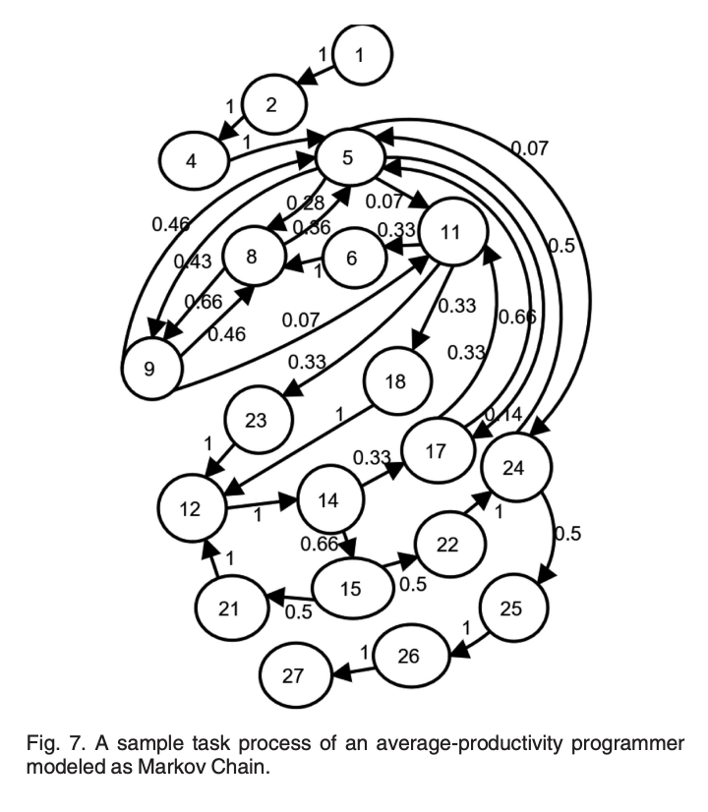
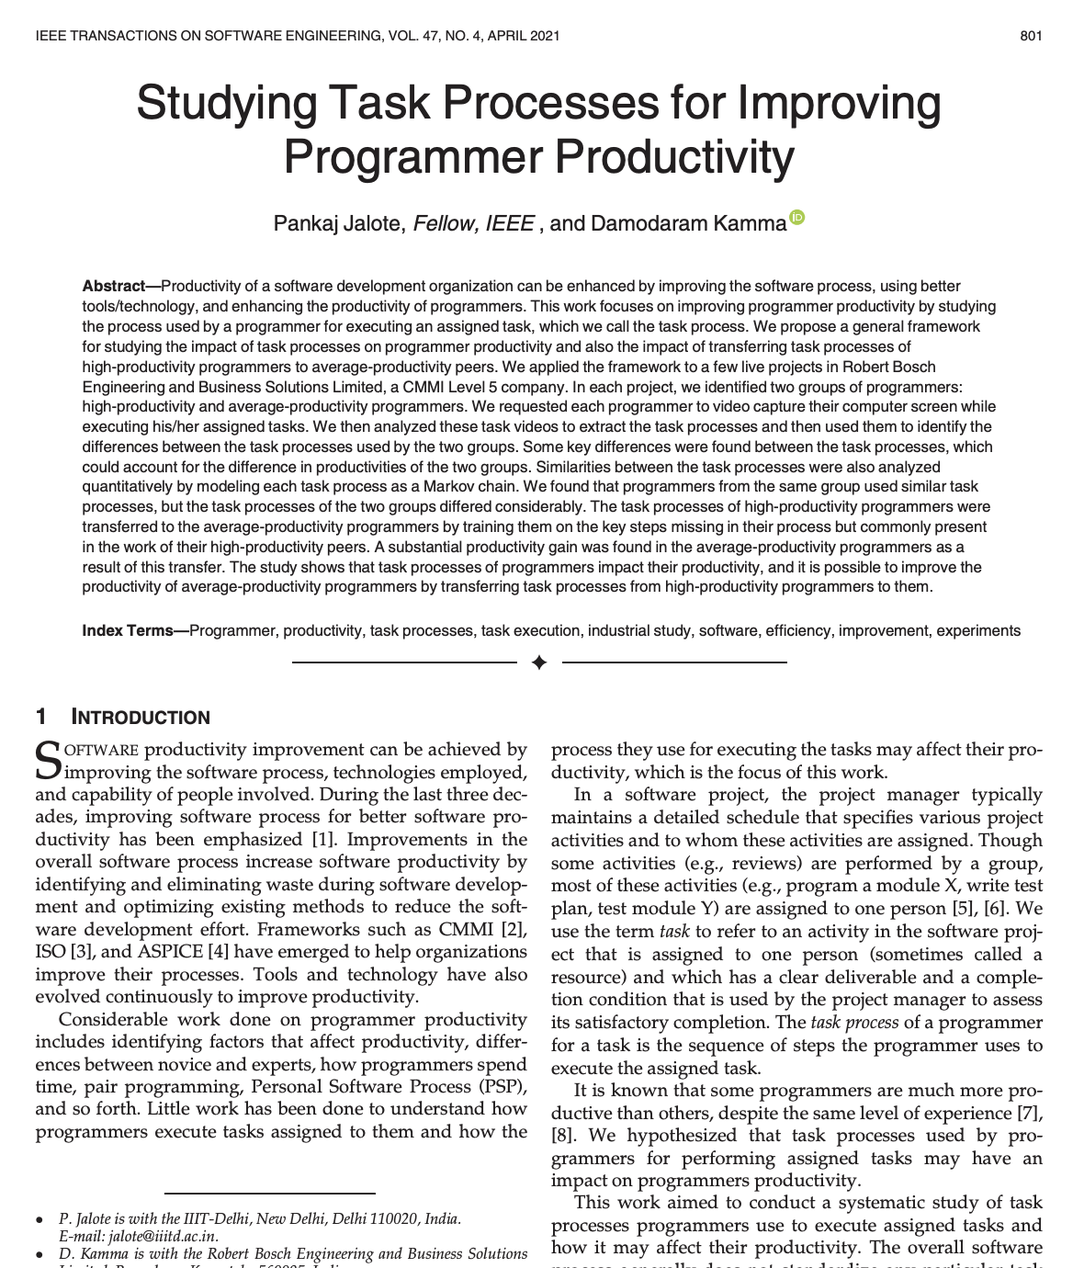
More "all over the place"
More stable
"We can therefore say that the task processes used by a high-productivity programmer for similar tasks are much closer to each other than the task processes used by an average-productivity programmer"

Slide 7
Testing principles
Exhaustive testing is impossible
Knowing when to stop
Variability is important (the pesticide paradox)
Bugs happen in some places more than others (defect clusters)
Testing will never be perfect
Context is king
Verification is not validation
In groups of 3, remember what these principles are about.
Each of you is responsible for explaining 2 principles to the others. The missing one, you decide who does it :)
Time: 7 minutes

Slide 8
Let's compare them
Exhaustive testing is impossible vs testing shows the presence of bugs but not their absence
Absence-of-errors fallacy vs pesticide paradox
Verification vs validation
Discuss the differences in groups of 3
Time: 5 minutes

Slide 9
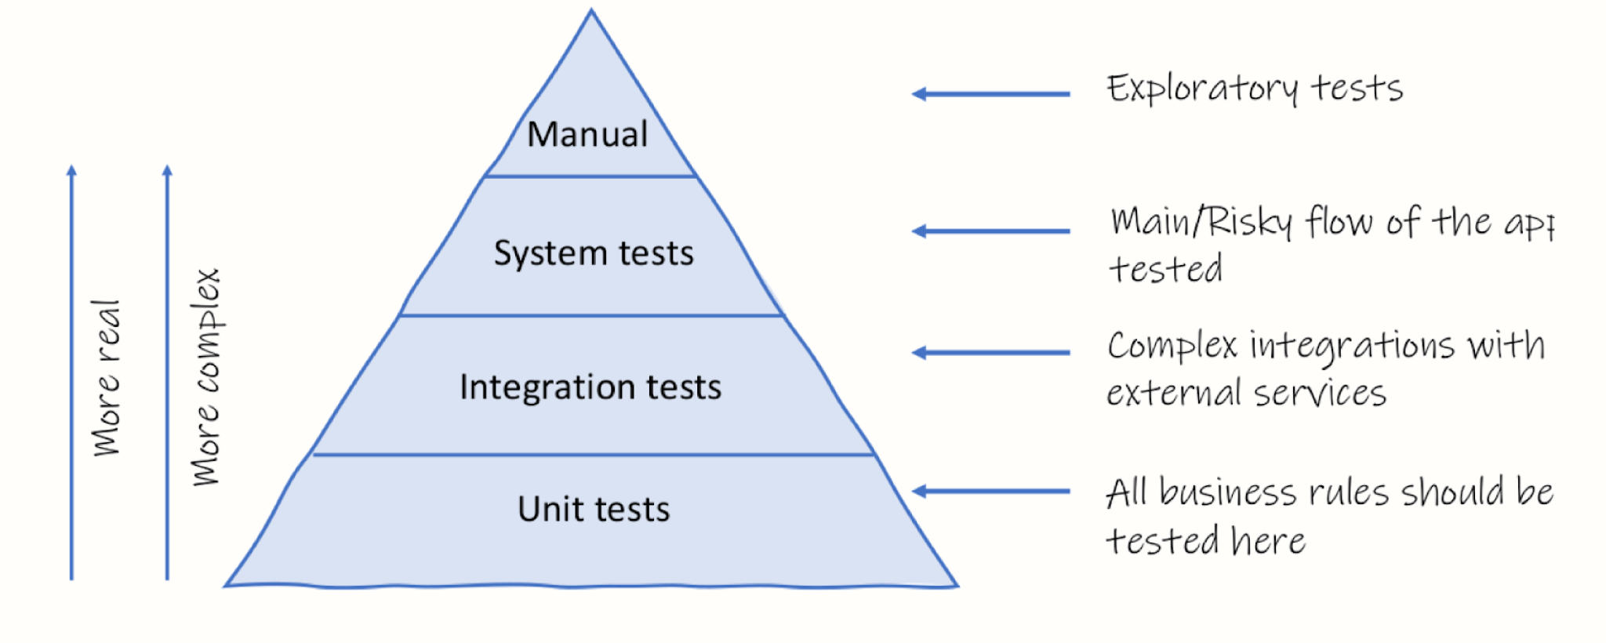
The testing pyramid

Slide 10
Can you think of reasons to do manual testing?

Slide 11
The ice-cream cone
system
integration
unit

Slide 12
Unit vs integration vs system testing
Deciding the test level isn't that straightforward
How would you do it?
What would you take into account to decide which test level to go for?
Personal taste plays a role?
Are you more of a 'unit testing type of person' or an 'integration testing type of person' ?
Discuss about it in groups of 3
Time: 5 minutes
Now share your thoughts with a group nearby
Time: 5 minutes

Slide 13
Fast vs slow tests
Does it matter if it's one or two classes tested altogether?
What do we really care about when we do "unit testing"?
Fast tests vs slow tests
What matters is:
How fast the test runs
How easy it is to write the test
How good the test feedback is

Slide 14
Time for Q&A!

Slide 15

License
The slides are licensed under CC-BY-NC-SA 2.0
https://creativecommons.org/licenses/by-nc-sa/4.0/
If you use this deck of slides in any way (as is or derived), please add a reference to the book and to its website (effective-software-testing.com)
The photos come from various artists in Unsplash.
The icons come from iconfinder.com.

Slide 16
Lab-0 Submission
Email the TA and CC me. Use the subject line: “LSU-CSC-4332-Lab-0 <Your Name> <LSU ID>”.
Attach a screenshot of your IDE showing that the code ran successfully, and the file DelftCaseUtilitiesTest.java.

